Slide 1





Interactive Policy Shaping for Human-Robot Collaboration with Transparent Matrix Overlays
Jake Brawer, Debasmita Ghose, Kate Candon, Meiying Qin, Alessandro Roncone, Marynel Vázquez, Brian Scassellati
ACM/IEEE International Conference on Human-Robot Interaction 2023 Stockholm, SE (p. 525-533)
Best Technical Paper
Guilherme Santos - 113893
Pedro Pinto - 115304

Slide 2

Motivation
Human-Robot Collaboration (HRC)
Reinforcement Learning (RL)
Adaptation to user preferences
Learning via shielding
[IMAGE]
Learning Policies via shielding: https://doi.org/10.1109/HRI53351.2022.9889604

Slide 3

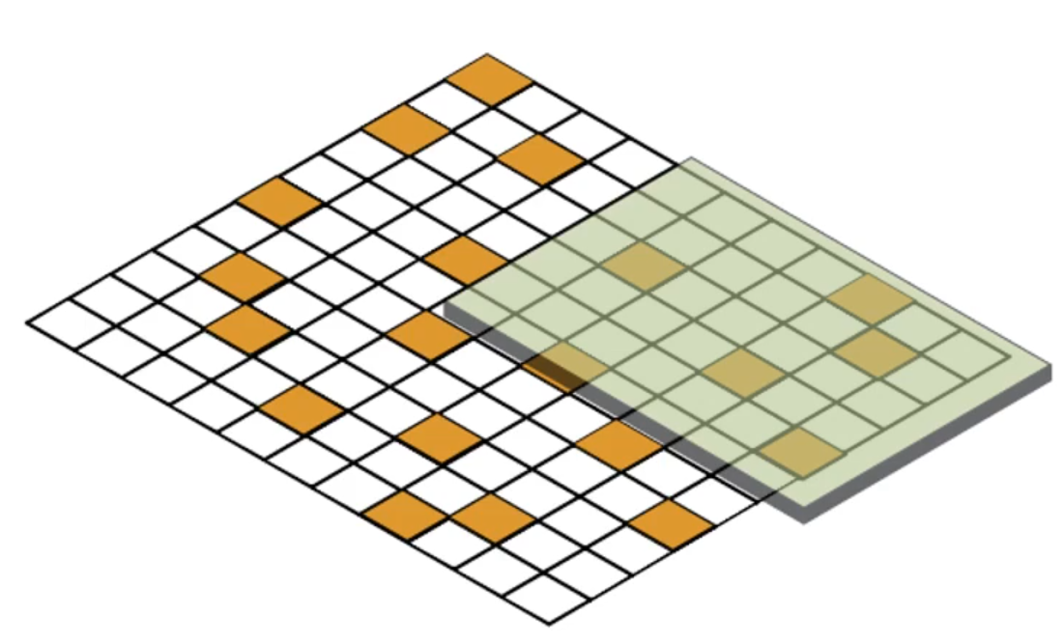
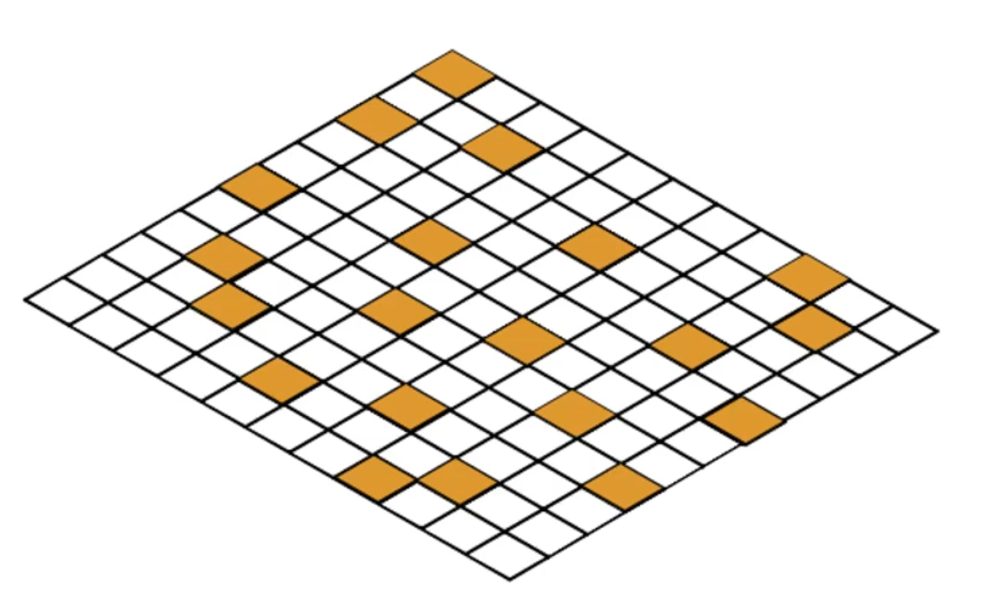
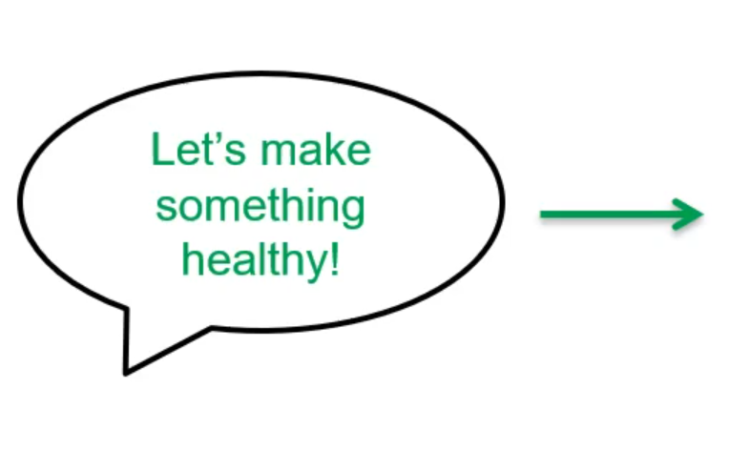
Transparent Matrix Overlays
Overview
Q-value matrix
Policy
Notes:
Q-value matrix. [state, action] Policie: conjunto de comportamentos e ações que o agente vai executar até chegar a um determinado objetivo
O que desenvolveram? O que distingue das outras?
Não trabalha ao nível da Q-value matrix
Mas sim por cima dessa matrix, através de overlays
Essas overlays mudam a distribuição de probabilidades da Q-value matrix

Slide 4
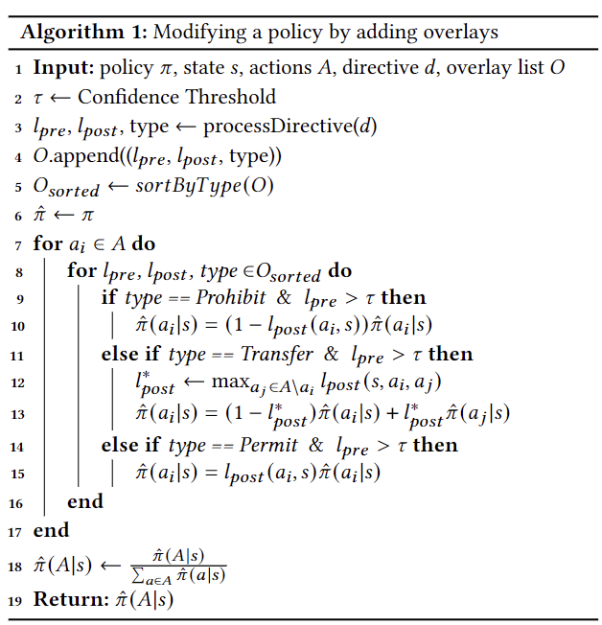
Transparent Matrix Overlays
Types of overlays
Prohibitory Overlay
rules that prohibit actions
Transfer Overlay
transfer probability density
Permissive Overlay
rules that permit actions
Notes:
If-this-then-that. IF l_pre THEN l_pos Prohibitory:
no estado s a ação a_i vai ter a sua probabilidade invertida
Transfer:
calcula a probabilidade de transição, e considera o caso de não acontecer i somando com o caso de acontecer j. (transição de i para j)
Permissive:
aumenta simplesmente a probabilidade

Slide 5
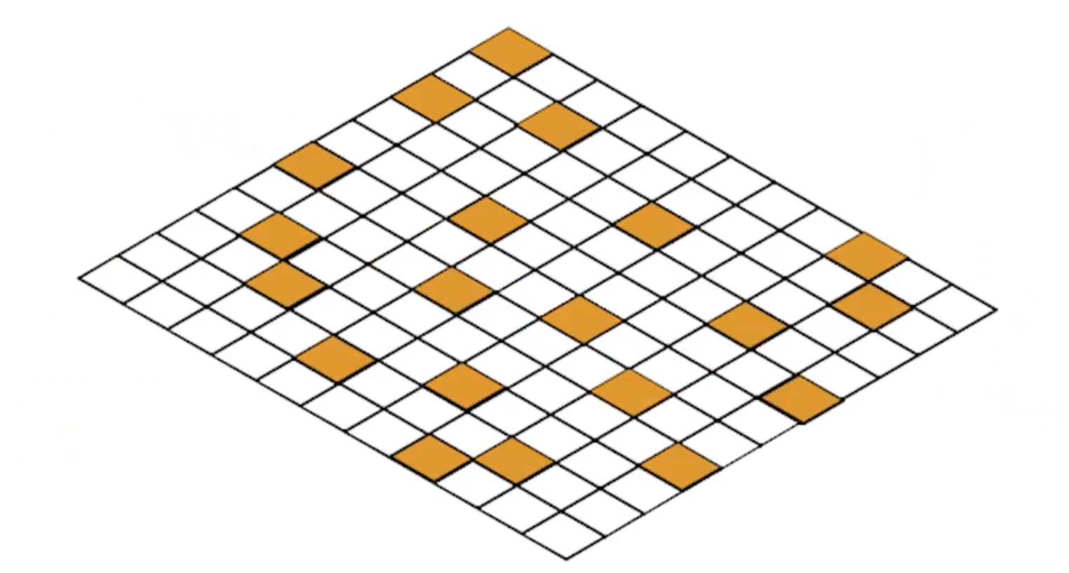
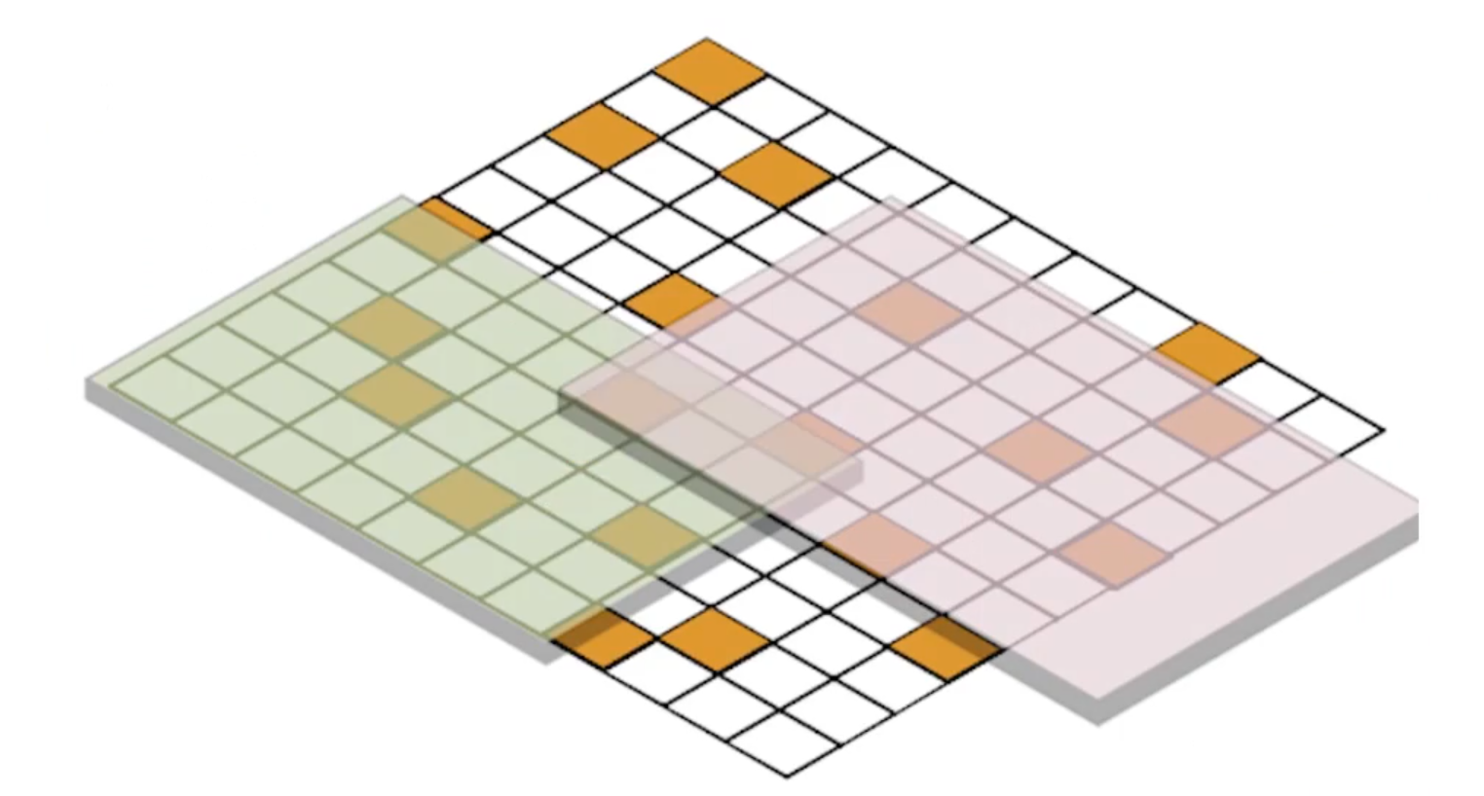
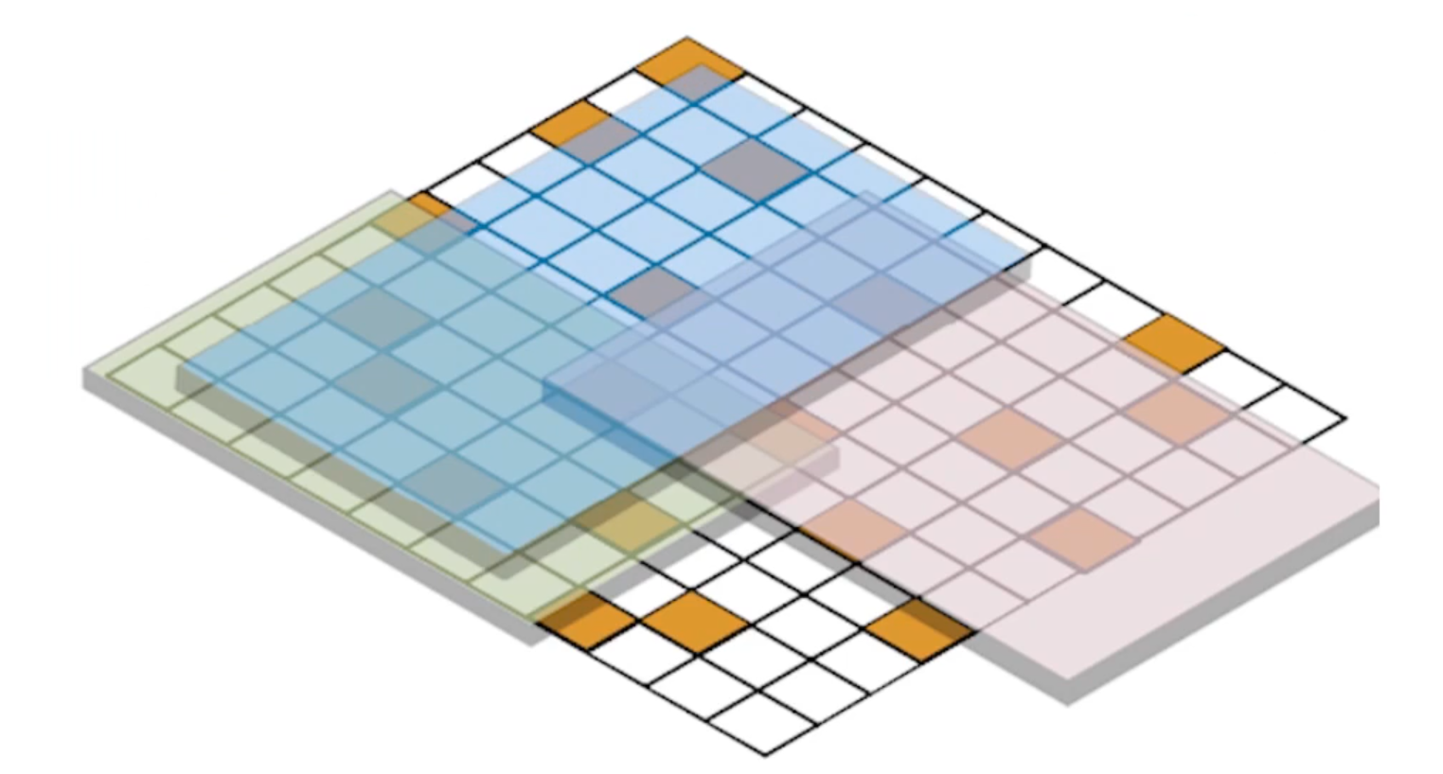
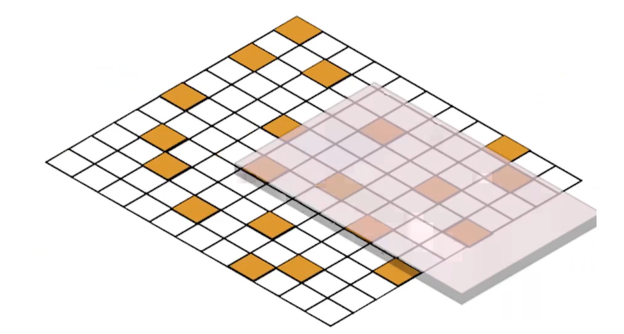
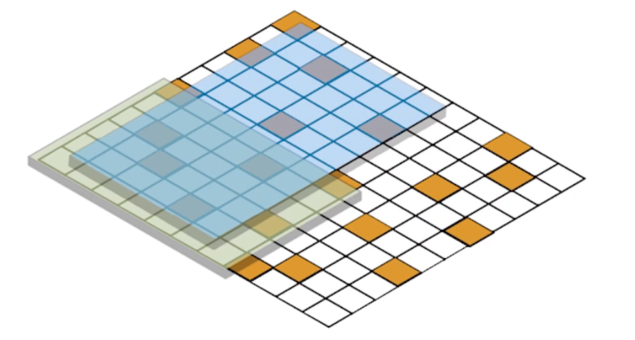

Transparent Matrix Overlays
Composability and Removing
Overlay List

Slide 6
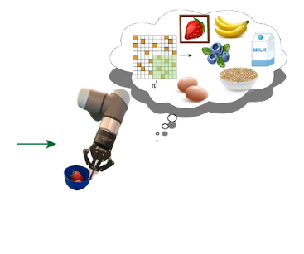
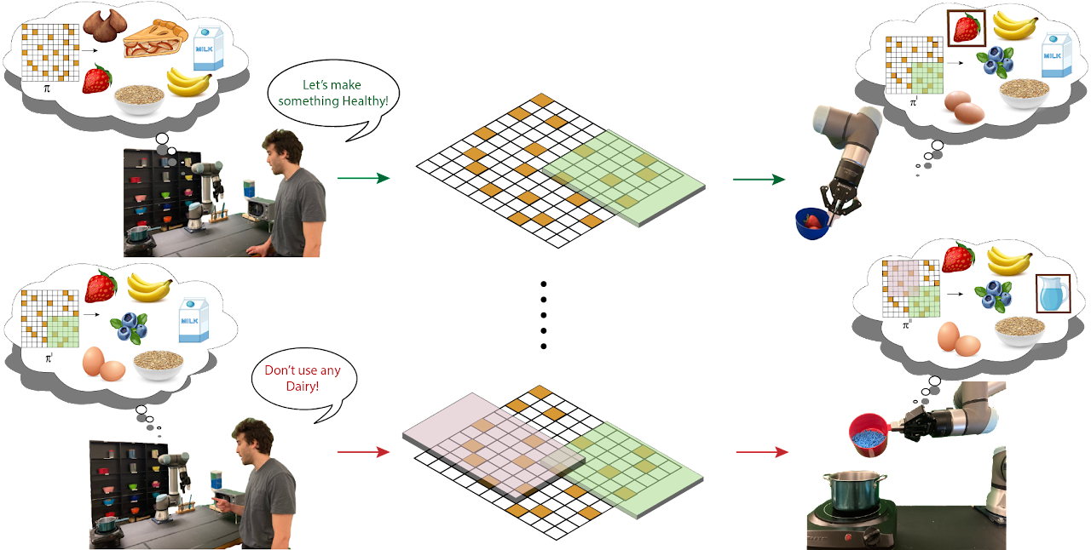


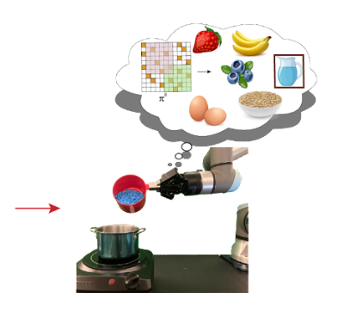
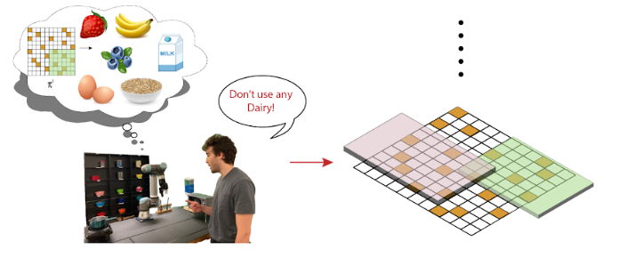
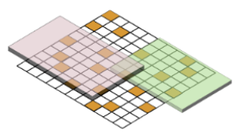
Transparent Matrix Overlays
Prohibitory and Permissive Overlays

Slide 7
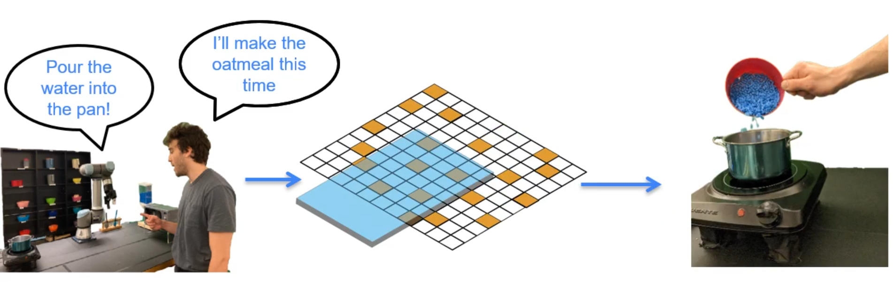
Transparent Matrix Overlays
Transfer Overlays

Slide 8
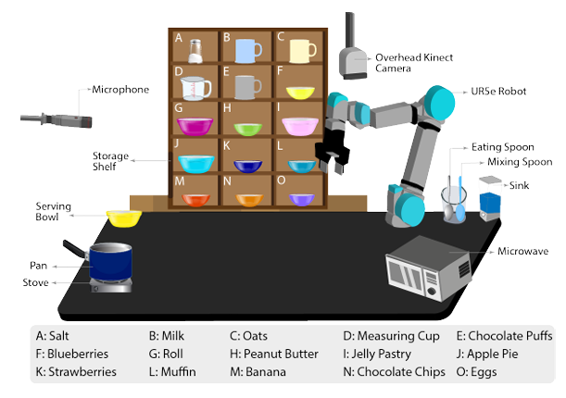
Experiments
Assistive cooking
Rapid and temporary changes
Adaptive and flexible policies
Environment
Simulated vs Physical

Slide 9
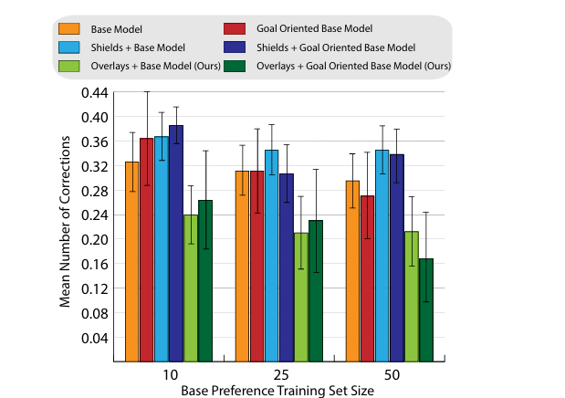
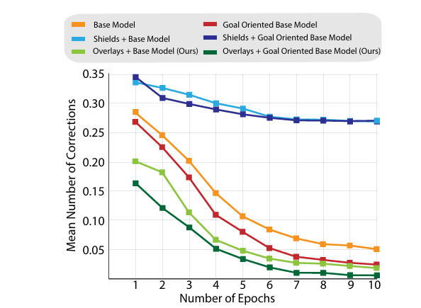
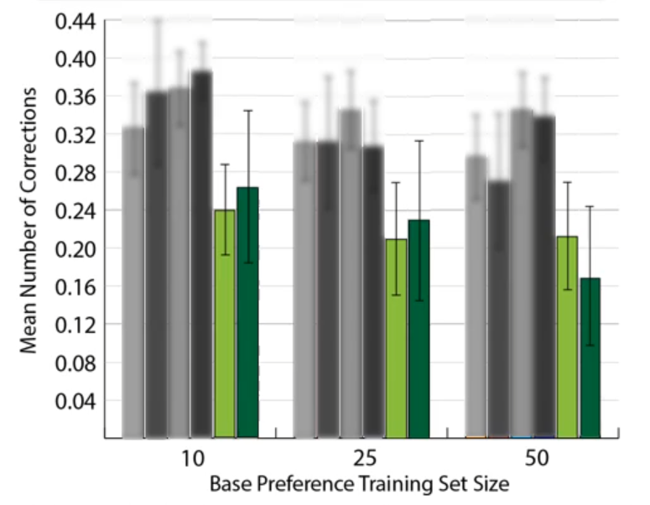
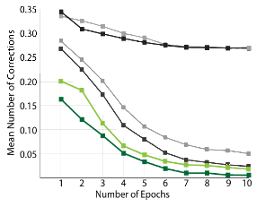
Simulated Tests
No Retraining Test vs Retraining Test

Slide 10
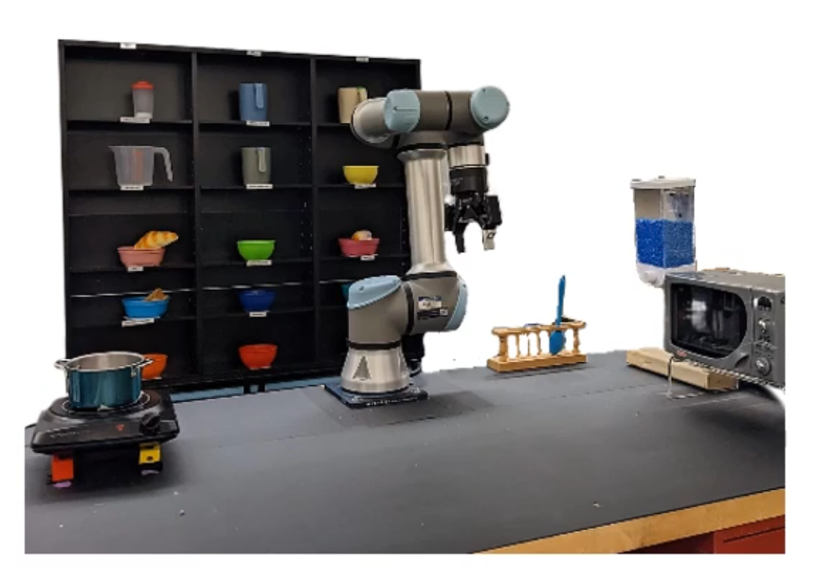

Physical Robot Tests
Proof-of-concept experiments
(video)

Slide 11
Physical Robot Tests
Results of the Case Study
Number of Errors | Base Model | Overlay-assisted robot
All Types | 14 | 2
(previous slide) | 6 | 2
only Permissive | 3 | 0
-700%
-300%
-300%
3 experienced users in each test
same base policy form simulated tests

Slide 12
Conclusion
Immediate adaptation to user preferences
Physical Tests with few users
Limitations:
Hand-crafted predicates
Scalability
What’s next?

Slide 13
Interactive Policy Shaping for Human-Robot Collaboration with Transparent Matrix Overlays
Jake Brawer, Debasmita Ghose, Kate Candon, Meiying Qin, Alessandro Roncone, Marynel Vázquez, Brian Scassellati
ACM/IEEE International Conference on Human-Robot Interaction 2023 Stockholm, SE (p. 525-533)
Questions?
Best Technical Paper
Guilherme Santos - 113893
Pedro Pinto - 115304

